Slide 1
Internship Review Presentation
A Jatin Sandilya
(C&IB)
14 July 2016
1

Slide 2
Project Scope
The BDD paradigm
- Java & the build environment
- Spring.io
Agile Methodology
ii. Backend Testing Automation
- Evaluation and Analysis of BDD Frameworks ( Cucumber-JVM and Jbehave )
2

Slide 3
Behaviour Driven Development
OVERVIEW
A software development methodology in which an application is specified and designed by describing how its behavior should appear to an outside observer.
OBJECTIVES
To understand a typical workflow of development using the said technique.
Understand why such an approach could be useful.
Differentiate between BDD and other *DD methodologies.
To implement an application using the BDD best practices with the available frameworks.
3

Slide 4
Week 1
PLAN
On-boarding.
Setup the build environment.
Get comfortable working with Java .
Get Familiar with Junit xUnit testing methods.
Understand the build lifecycle of a project using Apache Maven.
4

Slide 5
Week 2
PLAN
Become proficient in Java
Understand how Spring framework works.
Thoroughly understand concepts such as Dependency Injection and Aspect Oriented Programming in Spring framework.
5

Slide 6


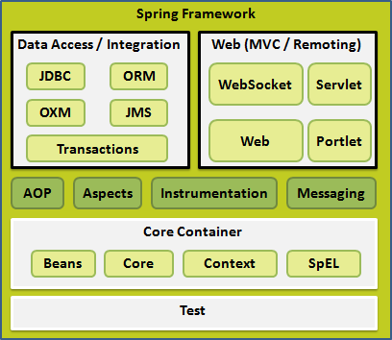
6

Slide 7
Week 3
PLAN
Implement Spring web Applications for learning.
Create an End-to End Spring Application.
Get familiar with Cucumber-JVM.
Write sample test suites for learning.
Create the same Spring application through BDD using Cucumber-JVM, mark the differences and introspect .
7

Slide 8
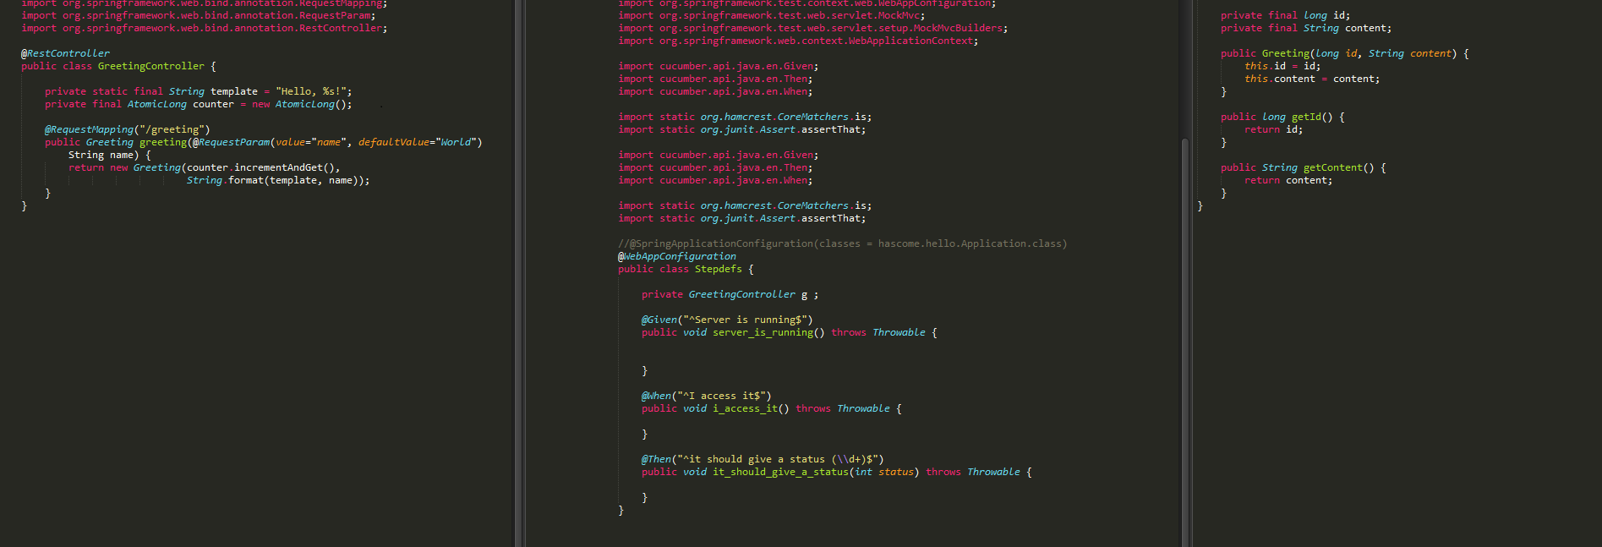
Spring REST web Service
8

Slide 9
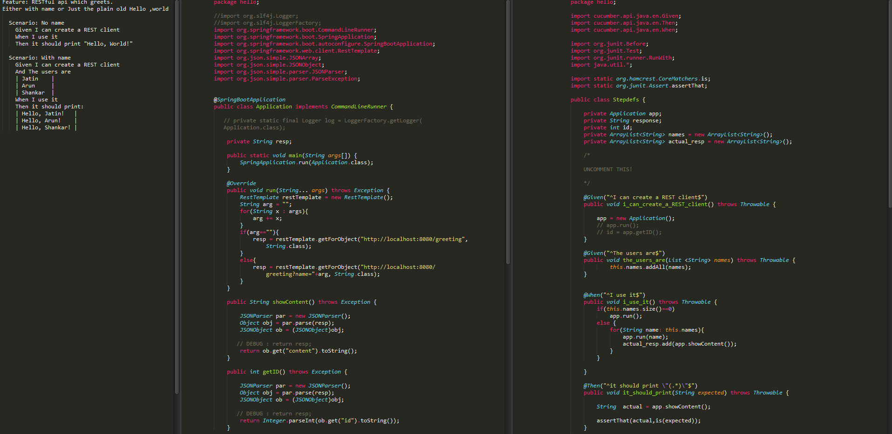
Backend Test Automation using Cucumber-JVM
9

Slide 10
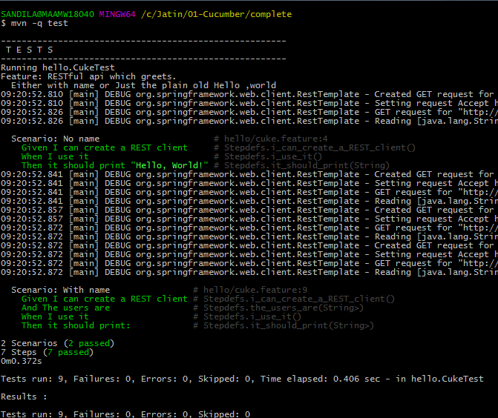
Backend Test Automation-Reports(Cucumber)
10

Slide 11
Week 4
PLAN
Get familiar with Jbehave framework.
Write sample test suites for learning.
Create the same Spring application through BDD using JBehave, mark the differences and introspect.
To understand Agile methodology and Scrum.
SDLC and JIRA.
11

Slide 12
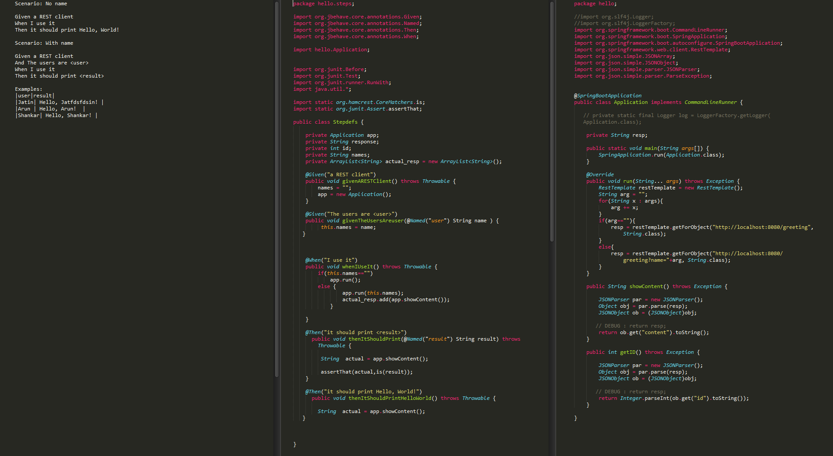
Backend Test Automation using JBehave
12

Slide 13
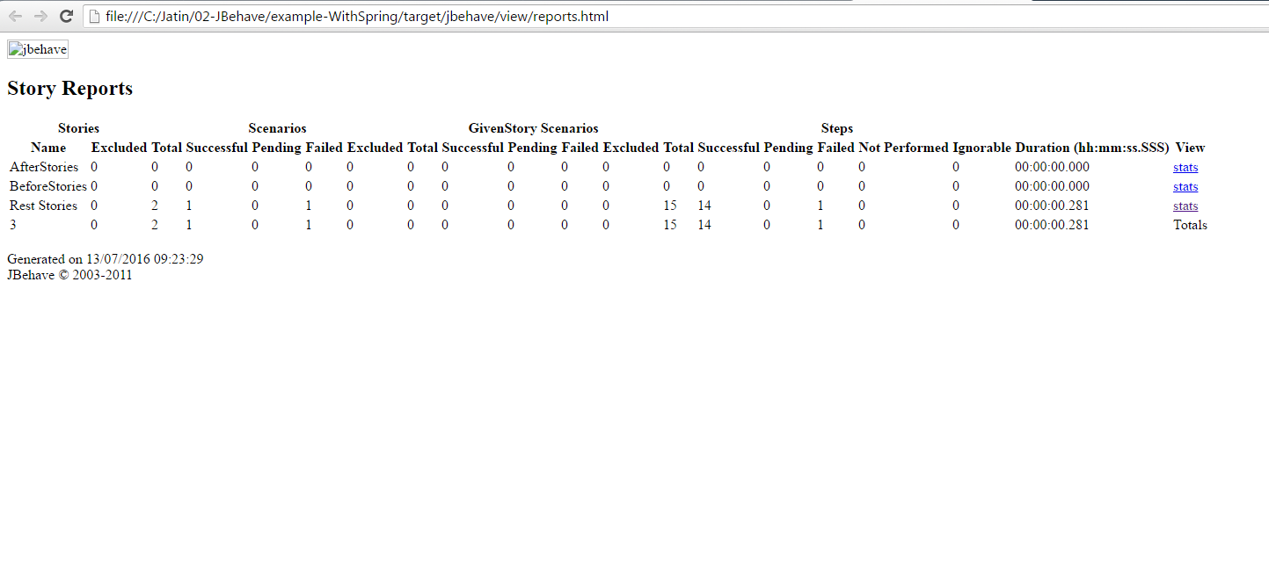
Backend Test Automation-Reports(Jbehave)
13

Slide 14
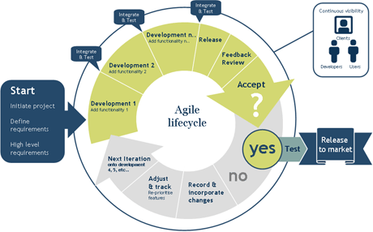
Agile in a nutshell
14

Slide 15
Week 5
PLAN
Understand Backend Automation thoroughly.
Analyse Cucumber-JVM and JBehave.
Compare the two using various parameters such as Documentation Support, Parameter Handling, etc.
Present a tech-talk to the fellow teammates about the findings and discuss and learn.
15

Slide 16
Feature Support | Winner
Documentation | JBehave
Flexibility in passing parameters | Cucumber
Auto-complete | Cucumber
Formatting Flexibility | Draw
Built-in Reports | Draw
Conformity To Standards | Cucumber
Input Data Sources | JBehave
JBehave vs Cucumber-JVM
16

Slide 17
Going further
Challenges Faced
Non-familiarity with Java and its environment.
Lack of domain knowledge in the initial stages.
17

Slide 18
Key Takeaways from the Internship
Understand web development and project lifecycle for an organisation as large as RBS
Domain knowledge on banking.
Understand how an organization functions and how projects are delivered.
Experience with Web Development in the Java environment and its best practices.
Understand the workflow of a project End-to-End.
Understand the role of each person in the development team and how teams should be formed.
Real taste of the Corporate World.
Professional Communication.
18

Slide 19
Key Learning
Technology | Java.
 | Spring.io, Maven, Terminal. Full Stack Web-dev . BDD workflow and hands on experience.
 | SDLC , Agile
 | Basics of Software Testing and Automation.
Domain | Basics of Banking Overview of Client On-Boarding Fusion and AMCorp
Miscellaneous | Professional attitude Team work, Communication Skills Processes Work Culture Coping with deadlines, colleagues
19

Slide 20
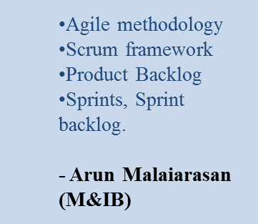
LEARNING
Sessions Attended:

Slide 21
Beyond the Job
All the interns visited an orphanage in Red Hills as a part of CSR. The kids were given food, and interesting activities for them like Quizzes, Dumb Charades and dancing were conducted.
Unforgettable Experience
21

Slide 22
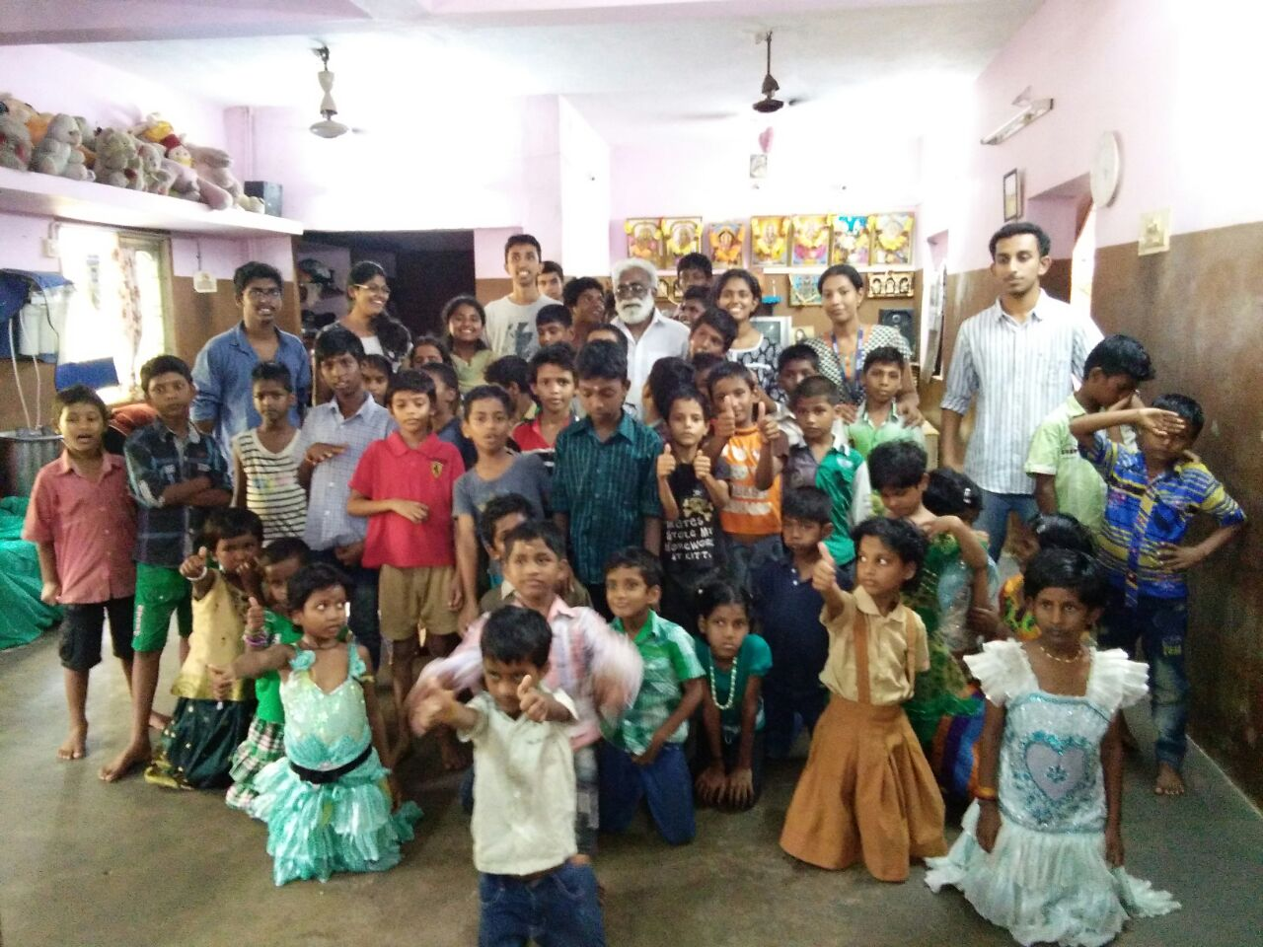
Beyond the Job
22

Slide 23
Thank You
23

